Slide 1
Single Statement, Many Changes
How One Statement Can Modify Multiple Tables
Deborah Melkin
Chicago Suburban SQL
July 21, 2020

Slide 2



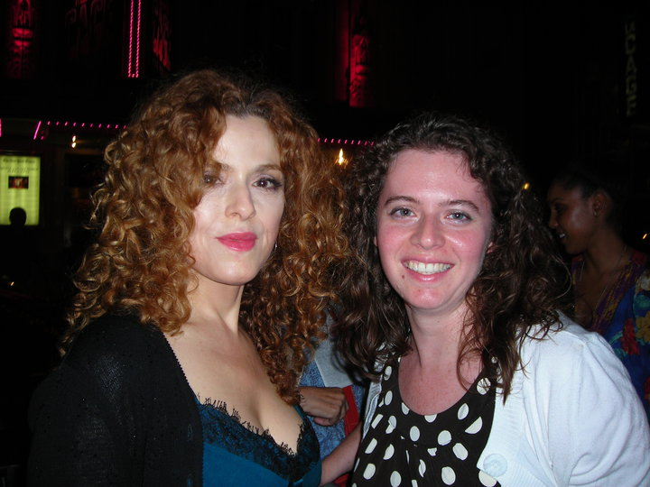
WHO AM I?
20 years as a DBA
Mainly work with SQL Server
Mainly work with OLTP but have worked with some data marts.
NESQL Board Member
SQL Saturday\User Group Speaker
IDERA ACE Class of 2020
Speaker Idol Winner 2019
Random facts:
I’m the alto section leader in my choir.
I go to bluegrass jams regularly.
I’ve been learning guitar and now mandolin.
I am a bit of a musical theater geek.

Slide 3
AGENDA
EXPLICIT CHANGES
IMPLICIT CHANGES
CHANGES AFTER THE CHANGES

Slide 4
EXPLICIT Changes
Changes that are Included Directly In the Statements

Slide 5
INSERTED \ DELETED
Internal System Tables that exist during a transaction to store the data as existed before the change and as it will exist after the transaction is committed.
The table structure matches the table.
You cannot modify the inserted or deleted tables.
They are stored in memory.

Slide 6
OUTPUT INTO
Part of the DML statement
Directs the output to variables, table variables, tables
Limitations:
Cannot insert into a table that is any part of a foreign key constraint
Cannot insert into a table that has a trigger on it
Some restrictions with replication
Target cannot be a remote table, view or common table expression
Will always use a serial plan
Target table not eligible for parallelism
Notes:
General information: https://docs.microsoft.com/en-us/sql/t-sql/queries/output-clause-transact-sql?view=sql-server-ver15
Limitations: https://docs.microsoft.com/en-us/sql/t-sql/queries/output-clause-transact-sql?view=sql-server-ver15#inserting-data-returned-from-an-output-clause-into-a-table

Slide 7
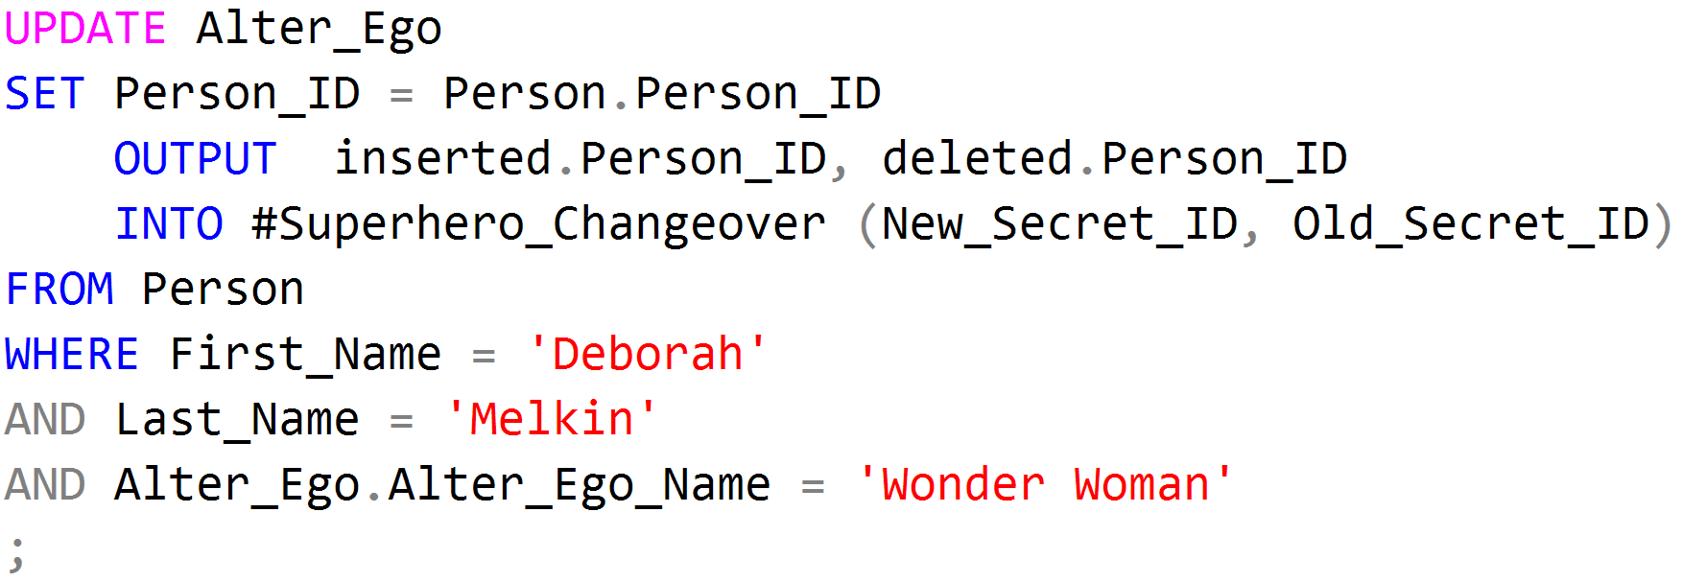
OUTPUT INTO
Notes:
General information: https://docs.microsoft.com/en-us/sql/t-sql/queries/output-clause-transact-sql?view=sql-server-ver15
Limitations: https://docs.microsoft.com/en-us/sql/t-sql/queries/output-clause-transact-sql?view=sql-server-ver15#inserting-data-returned-from-an-output-clause-into-a-table

Slide 8
Triggers
Stored Procedures attached to a table or view executed as part of the data change
After the change
Instead of the change
Part of the same transaction as the data change statement
Can be assigned to execute for INSERT, UPDATE or DELETE
Can have multiple triggers for the same or different actions on a single table
Can assign trigger to be the first or last trigger fired but no control in between

Slide 9
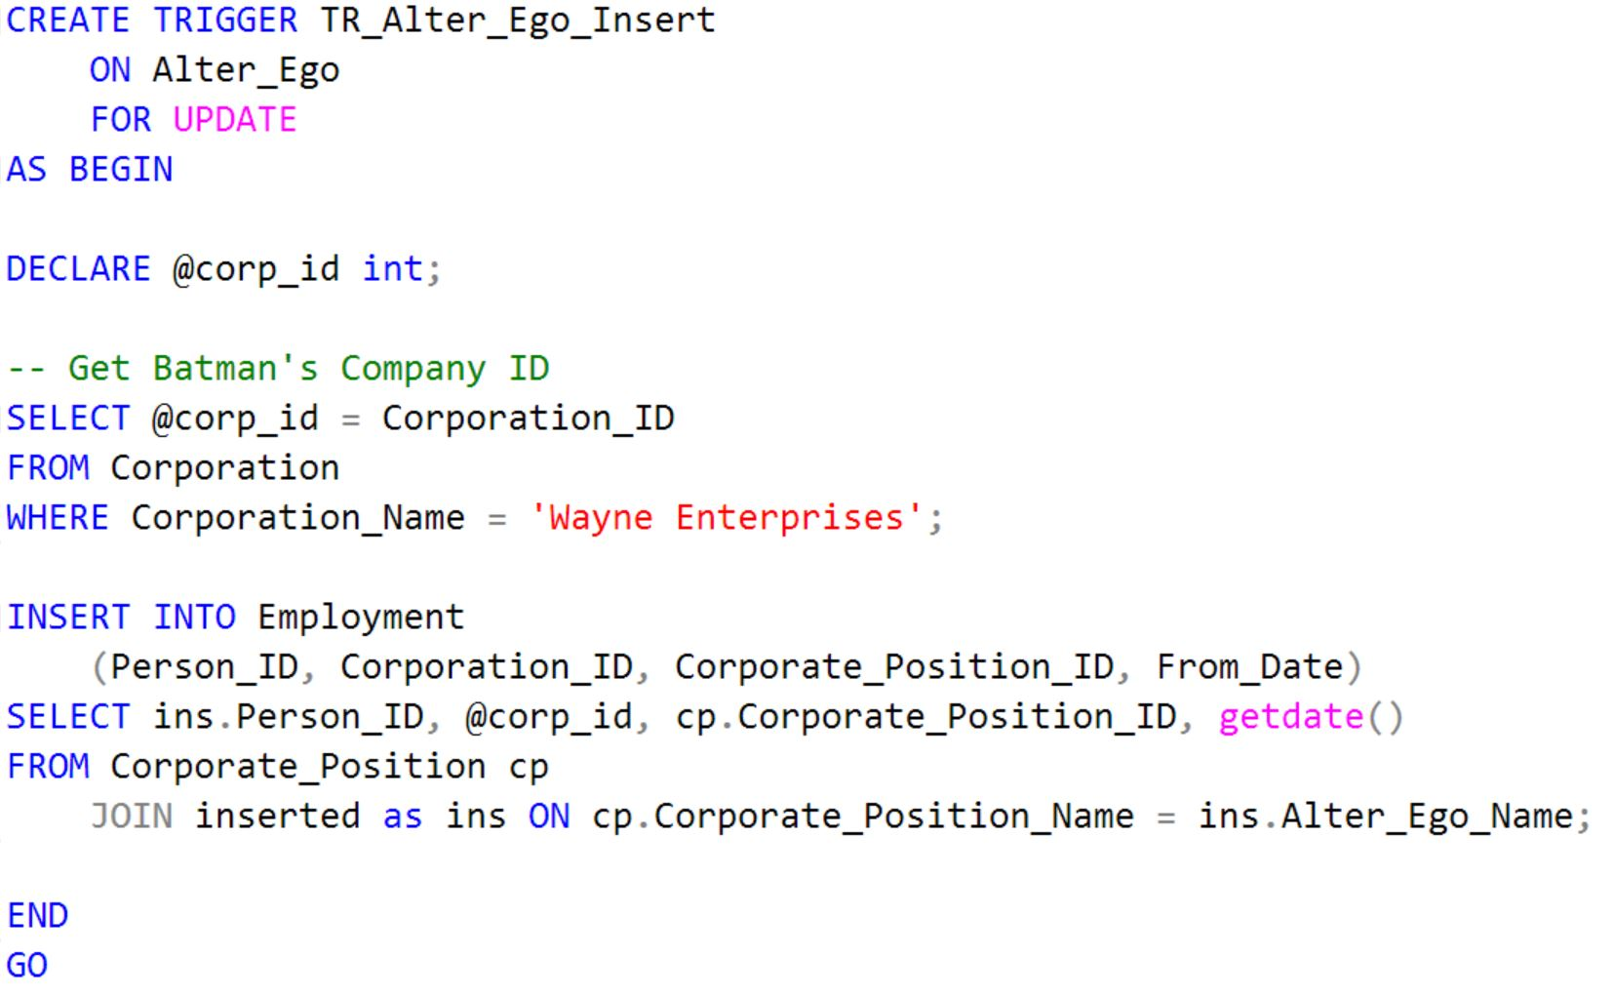
Triggers

Slide 10
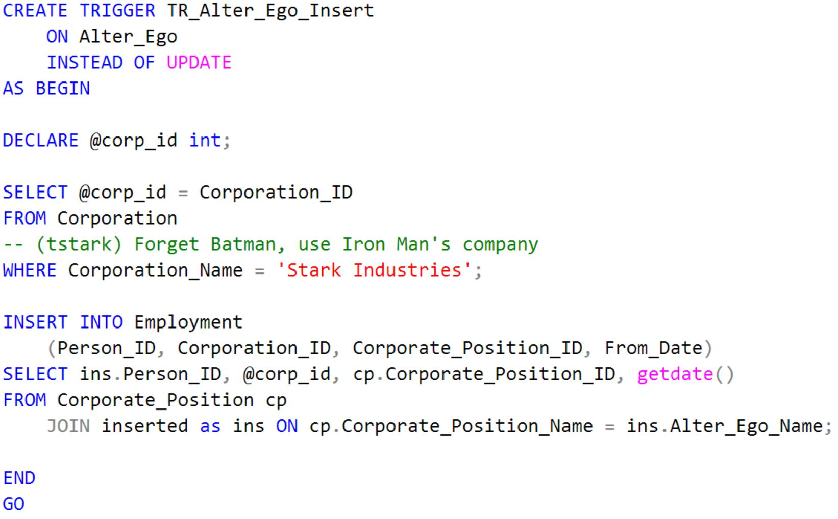
Triggers

Slide 11
IMPLICIT CHANGES
Changes that are built into the Database Schema

Slide 12
Cascading Foreign Keys
Defines actions that should be taken on the referencing columns when the referenced column is updated or referenced row is deleted
SET NULL
Sets the referencing column to NULL
SET DEFAULT
Sets the referencing column to a default value
CASCADE
Updates the referencing column to the same value as the referenced column
Deletes the referencing record when the referenced record is deleted
NO ACTION

Slide 13
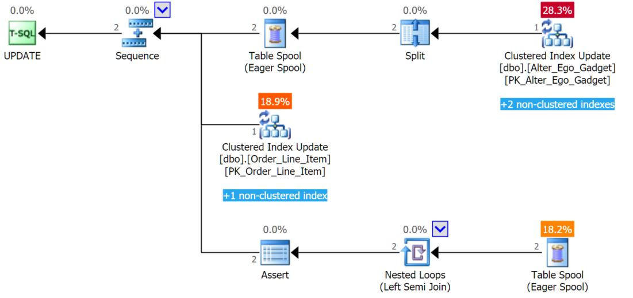
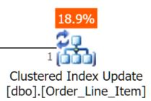
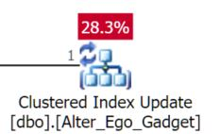
Cascading Foreign Keys
Table with Cascading FK
Table being updated

Slide 14
Temporal Tables
Creates system version of the changes to a table
Only records UPDATEs and DELETEs
Versioning is managed by the system
History table can be created automatically by SQL Server or it can be specified
Retention for data in the history table can be specified start with SQL 2017
Limitations:
The history table must exist in the same database
Cannot manually modify the system date columns on the table being versioned.
No direct data modification of the history table
Some restrictions with Replication

Slide 15
TEMPORAL TABLES
Can query the table to return the data as it existed at a point in time
Options for querying data:
AS OF
FROM
BETWEEN
CONTAINED IN
ALL
Notes:
https://docs.microsoft.com/en-us/sql/relational-databases/tables/querying-data-in-a-system-versioned-temporal-table?view=sql-server-ver15

Slide 16
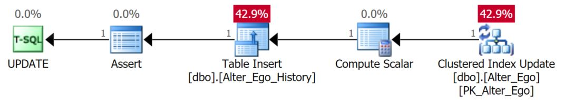
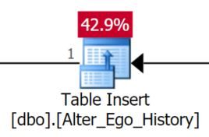
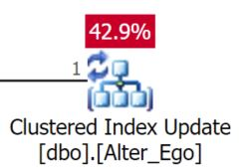
TEMPORAL TABLES
Insert into History Table
Table being updated
Notes:
https://docs.microsoft.com/en-us/sql/relational-databases/tables/querying-data-in-a-system-versioned-temporal-table?view=sql-server-ver15

Slide 17
AFTER THE TRANSACTION
CHANGES THAT HAPPEN BECAUSE OF THE CHANGE

Slide 18
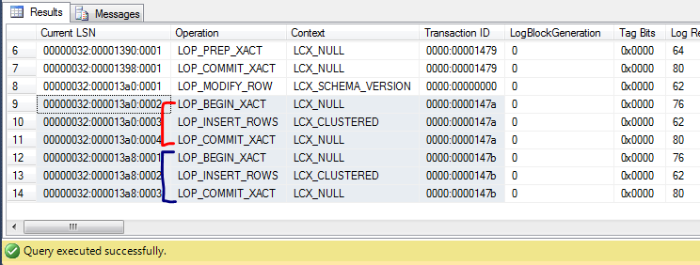
Log Readers
This Photo by Unknown Author is licensed under CC BY-SA

Slide 19
Replication
Data changes in the publication database are sent to one or more subscription databases
The distribution database stores metadata and history data for all types of replication, and transactions for transactional replication
Tables can be part of multiple subscriptions
Uses SQL Server Agent jobs to run the various tasks needed for Replication
Notes:
Distribution database definition taken from Microsoft website: https://docs.microsoft.com/en-us/sql/relational-databases/replication/distribution-database?view=sql-server-ver15

Slide 20
Replication
Multiple types of replication
Snapshot
Transactional
Peer-to-Peer
Merge
Subscriptions can be Push or Pull
Notes:
https://docs.microsoft.com/en-us/sql/relational-databases/replication/transactional/peer-to-peer-transactional-replication?view=sql-server-ver15

Slide 21
Change Data Capture (CDC)
“Before” and “After” data are written to system created tables for future use
Limitations
Cannot rename the objects or schemas
Default retention policy

Slide 22
Other Transaction Log Readers
Database Change Tracking
“lightweight” version of CDC
Availability Groups
Full replicas of the database
Synchronous and Asynchronous
The transaction log records of the primary database are sent to the secondary replicas

Slide 23
DemoS

Slide 24
Let’s Review

Slide 25
Take-Aways
Not all data modifications can be seen by traces
Not all data modifications occur in the same database
The amount of data that changes affects more than just the table but everything having to do with the transaction logs
Troubleshooting data modifications may not have to do with the initial update but changes that occur because of the updates

Slide 26
Additional Resources
OUTPUT
https://docs.microsoft.com/en-us/sql/t-sql/queries/output-clause-transact-sql?view=sql-server-ver15
https://docs.microsoft.com/en-us/sql/t-sql/queries/output-clause-transact-sql?view=sql-server-ver15#inserting-data-returned-from-an-output-clause-into-a-table
https://www.erikdarlingdata.com/2020/01/an-unfortunate-side-effect-of-output/
Temporal Tables
https://docs.microsoft.com/en-us/sql/relational-databases/tables/temporal-tables?view=sql-server-ver15

Slide 27
Additional Resource (cont’d)
CDC
https://docs.microsoft.com/en-us/sql/relational-databases/track-changes/about-change-data-capture-sql-server?view=sql-server-ver15
https://www.sqlshack.com/change-data-capture-for-auditing-sql-server/
Database Change Tracking:
https://www.sqlshack.com/creating-a-sql-server-audit-using-sql-server-change-tracking/
https://docs.microsoft.com/en-us/sql/relational-databases/track-changes/about-change-tracking-sql-server?view=sql-server-ver15

Slide 28


More Questions? Let me know!
Email: dgmelkin@gmail.com
Twitter: @dgmelkin
Blog: DebtheDBA.wordpress.com

Slide 29

Thanks for coming!
This Photo by Unknown Author is licensed under CC BY-NC-ND

